Slide 1
KS1 – Transition Day Maths

Slide 2
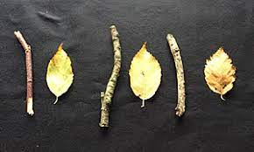
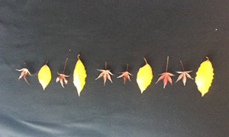
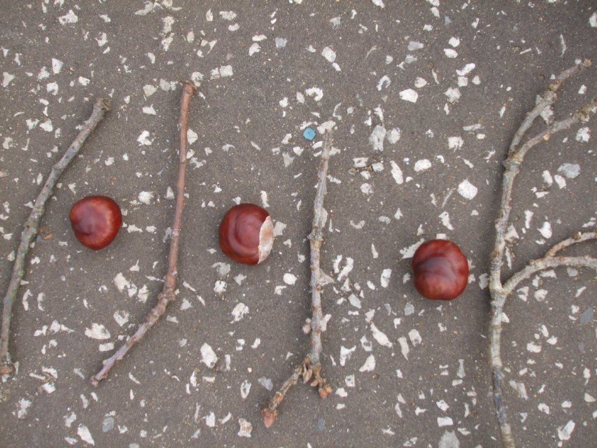
What do you notice?
Jenny and Fred have been out collecting objects from forest school.
They have arranged them like this:
What do you notice about how they have laid out their objects?

Slide 3
What Patterns have they made?
What is a pattern?
What patterns can you spot?
How do you know it is a pattern?

Slide 4
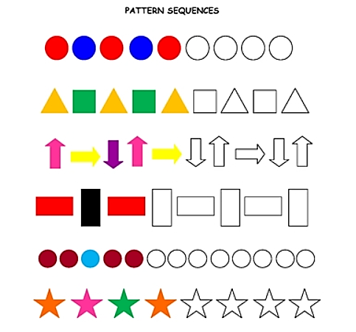
Your turn:
Can you complete the patterns using the correct colours
Challenge: Can you create your own patterns using 3, 4 or even 5 colours?

